Slide 1
Senior in the digital era
-Course support-
Data security
Material produced with the financial support of the European Union. The content of this material is the responsibility of the authors and the National Agency and the European Commission are not responsible for how the content of this information will be used.
Erasmus+ Programme – Strategic Partnership
Project : 2021-2-RO01-KA210-ADU-000048477
Project Title: “Senior in digital era”

Slide 2
Recapitulare & întrebări
Application:
We will build together
''Benefits Chart''
Material produced with the financial support of the European Union. The content of this material is the responsibility of the authors and the National Agency and the European Commission are not responsible for how the content of this information will be used.
Erasmus+ Programme – Strategic Partnership
Project : 2021-2-RO01-KA210-ADU-000048477
Project Title: “Senior in digital era”

Slide 3
Shop online safely
Verification seal and certificates
Check reviews
Shipping costs and returns:
Store origin
Material produced with the financial support of the European Union. The content of this material is the responsibility of the authors and the National Agency and the European Commission are not responsible for how the content of this information will be used.
Erasmus+ Programme – Strategic Partnership
Project : 2021-2-RO01-KA210-ADU-000048477
Project Title: “Senior in digital era”

Slide 4
Shop online safely
Fake reviews can be recognised by overly positive wording that sounds almost promotional, or by the fact that many positive reviews for a product have been written on a website in a very short space of time.
Material produced with the financial support of the European Union. The content of this material is the responsibility of the authors and the National Agency and the European Commission are not responsible for how the content of this information will be used.
Erasmus+ Programme – Strategic Partnership
Project : 2021-2-RO01-KA210-ADU-000048477
Project Title: “Senior in digital era”

Slide 5
Shop online safely
Application
We will divide into 5 groups. We will analyse together safe and dangerous sites.
Material produced with the financial support of the European Union. The content of this material is the responsibility of the authors and the National Agency and the European Commission are not responsible for how the content of this information will be used.
Erasmus+ Programme – Strategic Partnership
Project : 2021-2-RO01-KA210-ADU-000048477
Project Title: “Senior in digital era”

Slide 6
Online shopping
-safe payment methods-
Purchase with delayed payment
Cash on delivery
Online payment by credit card
Payment by Paypal
Payment with a prepaid card
Material produced with the financial support of the European Union. The content of this material is the responsibility of the authors and the National Agency and the European Commission are not responsible for how the content of this information will be used.
Erasmus+ Programme – Strategic Partnership
Project : 2021-2-RO01-KA210-ADU-000048477
Project Title: “Senior in digital era”

Slide 7
Online shopping
-safe payment methods-
Application
We will be grouped into 5 teams.
We will discuss the risks and benefits of each method.
Material produced with the financial support of the European Union. The content of this material is the responsibility of the authors and the National Agency and the European Commission are not responsible for how the content of this information will be used.
Erasmus+ Programme – Strategic Partnership
Project : 2021-2-RO01-KA210-ADU-000048477
Project Title: “Senior in digital era”

Slide 8
Booking a journey
safely
The ad gives full details of the trip
TOUR OPERATOR
Material produced with the financial support of the European Union. The content of this material is the responsibility of the authors and the National Agency and the European Commission are not responsible for how the content of this information will be used.
Erasmus+ Programme – Strategic Partnership
Project : 2021-2-RO01-KA210-ADU-000048477
Project Title: “Senior in digital era”

Slide 9
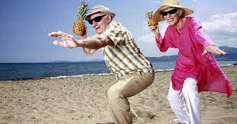
Booking a journey
safely
Material produced with the financial support of the European Union. The content of this material is the responsibility of the authors and the National Agency and the European Commission are not responsible for how the content of this information will be used.
Erasmus+ Programme – Strategic Partnership
Project : 2021-2-RO01-KA210-ADU-000048477
Project Title: “Senior in digital era”

Slide 10
Banking services at
home
account management via internet
HOMEBANKING
There are available
options for
contact with
bank advisors or
helplines
access through
smartphone
or tablet
24 hours a day
Material produced with the financial support of the European Union. The content of this material is the responsibility of the authors and the National Agency and the European Commission are not responsible for how the content of this information will be used.
Erasmus+ Programme – Strategic Partnership
Project : 2021-2-RO01-KA210-ADU-000048477
Project Title: “Senior in digital era”

Slide 11
Banking services at
home
Application
Group into 5 teams.
We will discuss the advantages and the risks
about home banking.
* In each team there will be 3 people*
Material produced with the financial support of the European Union. The content of this material is the responsibility of the authors and the National Agency and the European Commission are not responsible for how the content of this information will be used.
Erasmus+ Programme – Strategic Partnership
Project : 2021-2-RO01-KA210-ADU-000048477
Project Title: “Senior in digital era”

Slide 12
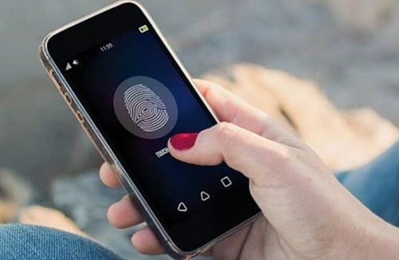
Smartphone security
PIN code for SIM card
Set screen lock
Check for updates
Do not open links
Material produced with the financial support of the European Union. The content of this material is the responsibility of the authors and the National Agency and the European Commission are not responsible for how the content of this information will be used.
Erasmus+ Programme – Strategic Partnership
Project : 2021-2-RO01-KA210-ADU-000048477
Project Title: “Senior in digital era”

Slide 13
Tips for safe online surfing
GENERAL GUIDELINES
EFFICIENT
PASSWORDS
https-http
Protect your home network
Do not download files and unknown attachments
Material produced with the financial support of the European Union. The content of this material is the responsibility of the authors and the National Agency and the European Commission are not responsible for how the content of this information will be used.
Erasmus+ Programme – Strategic Partnership
Project : 2021-2-RO01-KA210-ADU-000048477
Project Title: “Senior in digital era”

Slide 14
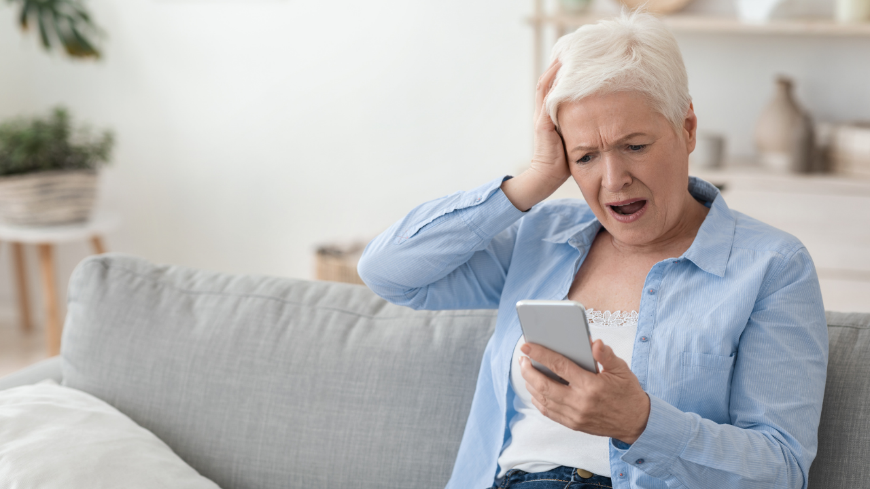
Protecting your email account, privacy and
personal data on
social networks
Material produced with the financial support of the European Union. The content of this material is the responsibility of the authors and the National Agency and the European Commission are not responsible for how the content of this information will be used.
Erasmus+ Programme – Strategic Partnership
Project : 2021-2-RO01-KA210-ADU-000048477
Project Title: “Senior in digital era”

Slide 15
SECURITY PASSWORDS
Passwords should be as secure as possible:
EX: My name is Ioana and I have 2 daughters!
Parola:
MniIoah2d!
This Photo by Unknown Author is licensed under CC BY-SA
Material produced with the financial support of the European Union. The content of this material is the responsibility of the authors and the National Agency and the European Commission are not responsible for how the content of this information will be used.
Erasmus+ Programme – Strategic Partnership
Project : 2021-2-RO01-KA210-ADU-000048477
Project Title: “Senior in digital era”

Slide 16
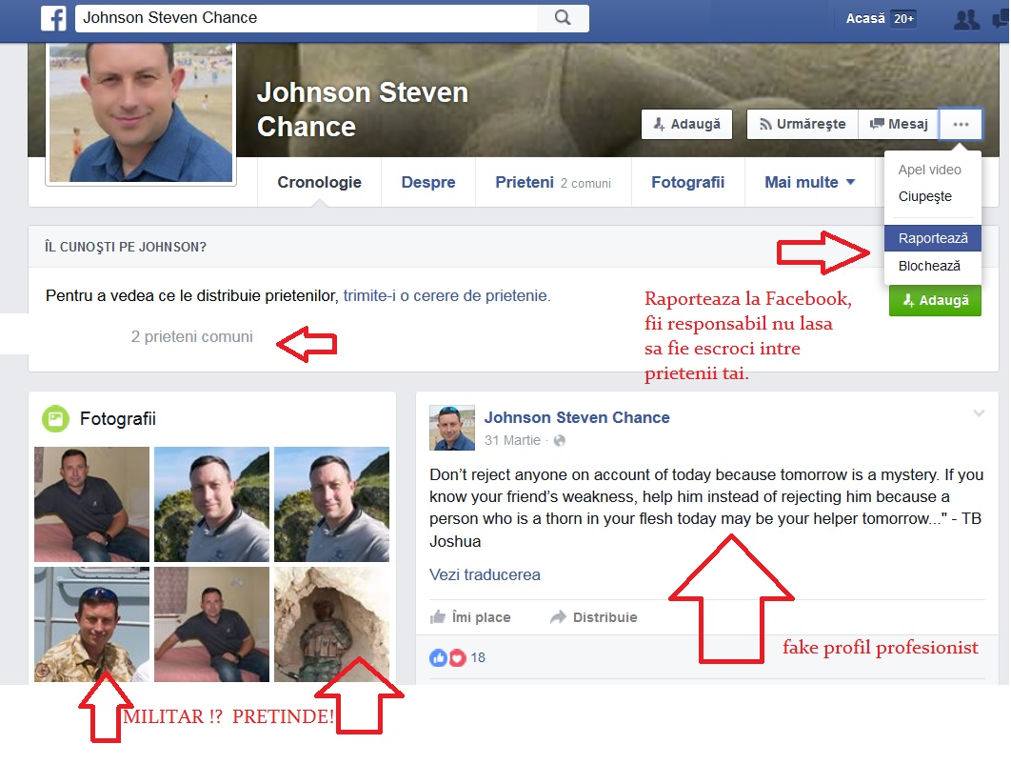
FAKE IDENTITY PROFILES
1.Too few profile pictures 1-3 fake account
2.The pictures don't look very similar to each other, or are pictures with sunglasses, or blurry pictures.
3. Pictures of military and soldiers, especially from abroad.
4.Too few 26-90 Friends, fake profile
5.Few interactions, comments on the page.
6.There are comments but only on pictures with sexual content on female profiles.
7.Females, too decorative girls in provocative poses can mean a fake profile.
8. Posts little, only pictures with flowers, quotes, links.
9. Don't answer the question Hello who are you?! How do we know each other.
10. You don't have many friends in common.
Material produced with the financial support of the European Union. The content of this material is the responsibility of the authors and the National Agency and the European Commission are not responsible for how the content of this information will be used.
Erasmus+ Programme – Strategic Partnership
Project : 2021-2-RO01-KA210-ADU-000048477
Project Title: “Senior in digital era”

Slide 17
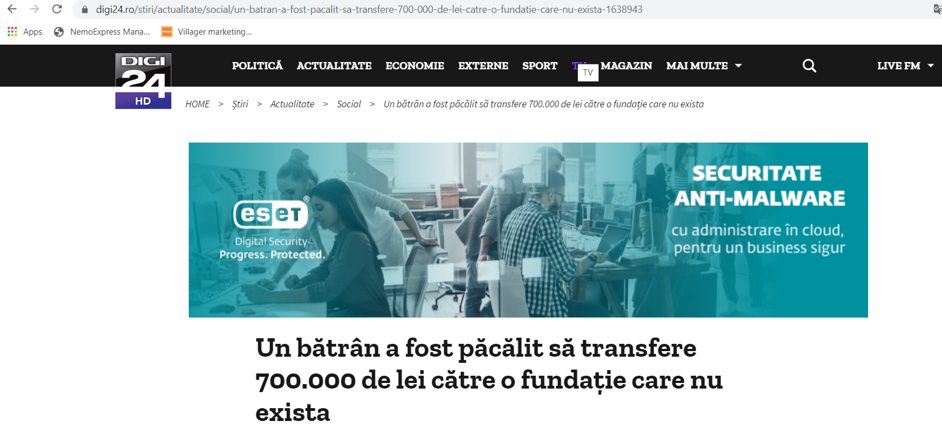
INTERNET SCAM
Material produced with the financial support of the European Union. The content of this material is the responsibility of the authors and the National Agency and the European Commission are not responsible for how the content of this information will be used.
Erasmus+ Programme – Strategic Partnership
Project : 2021-2-RO01-KA210-ADU-000048477
Project Title: “Senior in digital era”

Slide 18
PERSONAL INFORMATION
NO POSTING/NO OFFERING THEM ON THE PHONE:
-family information
-stories from your past
-address where you can be reached
-bank details
-your travel photos
-data from your ID card
-any form of personal data that other people have
might take advantage of
Material produced with the financial support of the European Union. The content of this material is the responsibility of the authors and the National Agency and the European Commission are not responsible for how the content of this information will be used.
Erasmus+ Programme – Strategic Partnership
Project : 2021-2-RO01-KA210-ADU-000048477
Project Title: “Senior in digital era”

Slide 19
FAKE POSTS
Application & review
We will group into 5 teams.
each team will analyse fake identity profiles.
KEEP IN MIND
Material produced with the financial support of the European Union. The content of this material is the responsibility of the authors and the National Agency and the European Commission are not responsible for how the content of this information will be used.
Erasmus+ Programme – Strategic Partnership
Project : 2021-2-RO01-KA210-ADU-000048477
Project Title: “Senior in digital era”

Slide 20
FAKE POSTS
DON'T believe everything you read on the internet!
-check posts on multiple sites. Watch out for sites with HTTP, HTTPS secure version
-look for information on specialised sites
-avoid receiving information from people
that are not specialised
-avoid buying from sites that are not complete
-before you buy something ask for information ask relatives or carers for their opinion on the internet
-don't ask for treatments without discussing with a specialist
Material produced with the financial support of the European Union. The content of this material is the responsibility of the authors and the National Agency and the European Commission are not responsible for how the content of this information will be used.
Erasmus+ Programme – Strategic Partnership
Project : 2021-2-RO01-KA210-ADU-000048477
Project Title: “Senior in digital era”

Slide 21
https://www.youtube.com/watch?v=t1hMBnIMt5I
Material produced with the financial support of the European Union. The content of this material is the responsibility of the authors and the National Agency and the European Commission are not responsible for how the content of this information will be used.
Erasmus+ Programme – Strategic Partnership
Project : 2021-2-RO01-KA210-ADU-000048477
Project Title: “Senior in digital era”

Slide 22
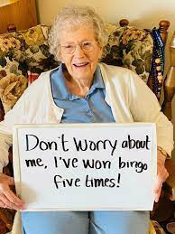
SENIOR BLOG
YOUR MESSAGE TO GENERATIONS IS ....
Material produced with the financial support of the European Union. The content of this material is the responsibility of the authors and the National Agency and the European Commission are not responsible for how the content of this information will be used.
Erasmus+ Programme – Strategic Partnership
Project : 2021-2-RO01-KA210-ADU-000048477
Project Title: “Senior in digital era”

Slide 23
THANK YOU FOR YOUR ATTENTION!
Material produced with the financial support of the European Union. The content of this material is the responsibility of the authors and the National Agency and the European Commission are not responsible for how the content of this information will be used.
Erasmus+ Programme – Strategic Partnership
Project : 2021-2-RO01-KA210-ADU-000048477
Project Title: “Senior in digital era”

