Slide 1
Seniors in the digital era
-Course support-
Deepening internet utilities for commerce,
administration and lifestyle
Material produced with the financial support of the European Union. The content of this material is the responsibility of the authors and the National Agency and the European Commission are not responsible for how the content of this information will be used.
Erasmus+ Programme – Strategic Partnership
Project : 2021-2-RO01-KA210-ADU-000048477
Project Title: “Senior in digital era”

Slide 2
Summary & questions
Application:
We will pair up in teams of 2 and
make a video call.
Material produced with the financial support of the European Union. The content of this material is the responsibility of the authors and the National Agency and the European Commission are not responsible for how the content of this information will be used.
Erasmus+ Programme – Strategic Partnership
Project : 2021-2-RO01-KA210-ADU-000048477
Project Title: “Senior in digital era”

Slide 3
Online entertainment for
seniors
Public service broadcasters' media libraries.
YouTube, the online video platform.
Streaming platforms: Netflix, Amazon Prime, etc.
Online radio stations and podcasts
Material produced with the financial support of the European Union. The content of this material is the responsibility of the authors and the National Agency and the European Commission are not responsible for how the content of this information will be used.
Erasmus+ Programme – Strategic Partnership
Project : 2021-2-RO01-KA210-ADU-000048477
Project Title: “Senior in digital era”

Slide 4
Online entertainment for
seniors
Application
We will split into 5 groups together we will access the media library of a local TV station. The app has several parts.
Material produced with the financial support of the European Union. The content of this material is the responsibility of the authors and the National Agency and the European Commission are not responsible for how the content of this information will be used.
Erasmus+ Programme – Strategic Partnership
Project : 2021-2-RO01-KA210-ADU-000048477
Project Title: “Senior in digital era”

Slide 5
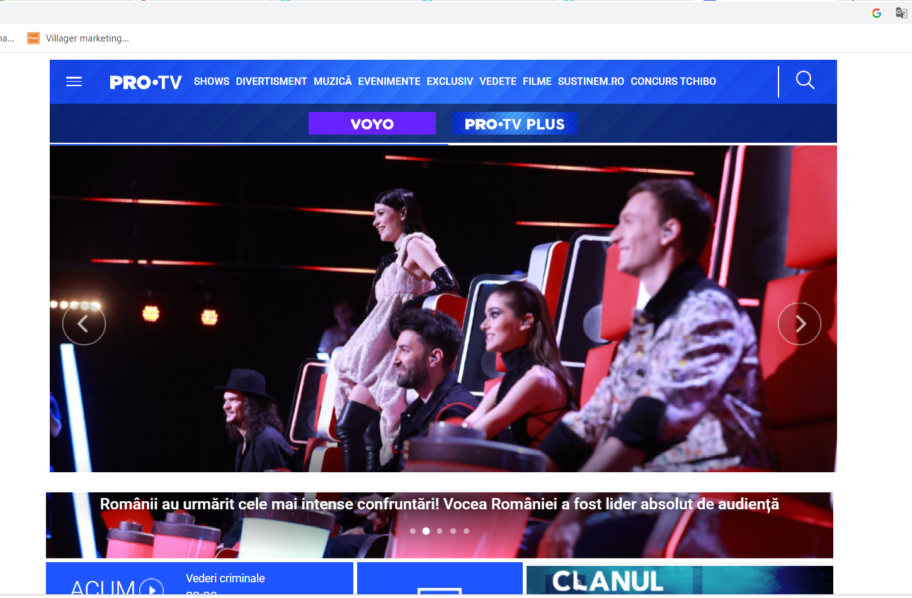
ENTERTAINMENT & INFORMATION
Material produced with the financial support of the European Union. The content of this material is the responsibility of the authors and the National Agency and the European Commission are not responsible for how the content of this information will be used.
Erasmus+ Programme – Strategic Partnership
Project : 2021-2-RO01-KA210-ADU-000048477
Project Title: “Senior in digital era”

Slide 6
HOBBIES FOR SENIORS
Platforms and sites for finding hobbies online:
YOUTUBE
PINTEREST
BLOG-URI
Google- an ideal search engine
Material produced with the financial support of the European Union. The content of this material is the responsibility of the authors and the National Agency and the European Commission are not responsible for how the content of this information will be used.
Erasmus+ Programme – Strategic Partnership
Project : 2021-2-RO01-KA210-ADU-000048477
Project Title: “Senior in digital era”

Slide 7
Material produced with the financial support of the European Union. The content of this material is the responsibility of the authors and the National Agency and the European Commission are not responsible for how the content of this information will be used.
Erasmus+ Programme – Strategic Partnership
Project : 2021-2-RO01-KA210-ADU-000048477
Project Title: “Senior in digital era”

Slide 8
Application:
We will be divided into groups of 5.
The application has several parts.
We will use: YOUTUBE to search for videos
We will use: Google to search about favourite hobby
Material produced with the financial support of the European Union. The content of this material is the responsibility of the authors and the National Agency and the European Commission are not responsible for how the content of this information will be used.
Erasmus+ Programme – Strategic Partnership
Project : 2021-2-RO01-KA210-ADU-000048477
Project Title: “Senior in digital era”

Slide 9
Online games and computer games
Examples of games:
-Simulation games ("Euro Train Simulator", "The Sims").
-Strategy games ("Anno", "Cities Skylines").
-Skill and memory games ("Sudoku" or games to find hidden objects).
-many games can be downloaded using PLAY STORE
Material produced with the financial support of the European Union. The content of this material is the responsibility of the authors and the National Agency and the European Commission are not responsible for how the content of this information will be used.
Erasmus+ Programme – Strategic Partnership
Project : 2021-2-RO01-KA210-ADU-000048477
Project Title: “Senior in digital era”

Slide 10
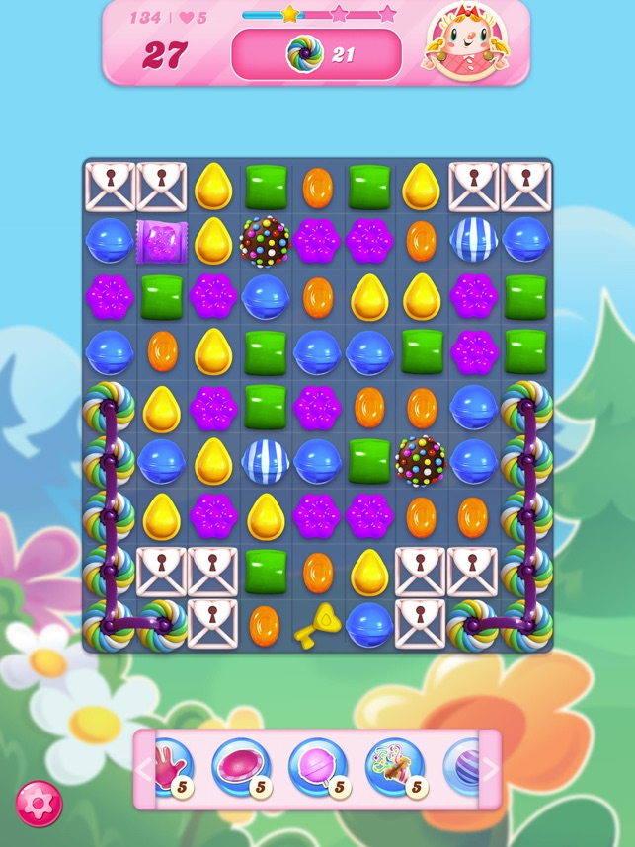
Material produced with the financial support of the European Union. The content of this material is the responsibility of the authors and the National Agency and the European Commission are not responsible for how the content of this information will be used.
Erasmus+ Programme – Strategic Partnership
Project : 2021-2-RO01-KA210-ADU-000048477
Project Title: “Senior in digital era”

Slide 11
Application:
We will be divided into groups of 5.
We will download a game. \We will search for a game online
For the game application we will use: Play Store
Material produced with the financial support of the European Union. The content of this material is the responsibility of the authors and the National Agency and the European Commission are not responsible for how the content of this information will be used.
Erasmus+ Programme – Strategic Partnership
Project : 2021-2-RO01-KA210-ADU-000048477
Project Title: “Senior in digital era”

Slide 12
ONLINE SHOPPING AND PAYMENTS
Advantages:
- no need to move from home if you don't want this work
- avoid queuing and standing
- with apps you can have a clear overview of your money
Disadvantages:
- there are situations where problems may arise in relation to the nature of transfers
- for more complicated problems there is telephone assistance but it is recommended
to be dealt with at a local bank branch
Material produced with the financial support of the European Union. The content of this material is the responsibility of the authors and the National Agency and the European Commission are not responsible for how the content of this information will be used.
Erasmus+ Programme – Strategic Partnership
Project : 2021-2-RO01-KA210-ADU-000048477
Project Title: “Senior in digital era”

Slide 13
ONLINE SHOPPING AND PAYMENTS
Application:
We will be divided into groups of 5.
The application will have several parts.
We will do a payment simulation online
Material produced with the financial support of the European Union. The content of this material is the responsibility of the authors and the National Agency and the European Commission are not responsible for how the content of this information will be used.
Erasmus+ Programme – Strategic Partnership
Project : 2021-2-RO01-KA210-ADU-000048477
Project Title: “Senior in digital era”

Slide 14
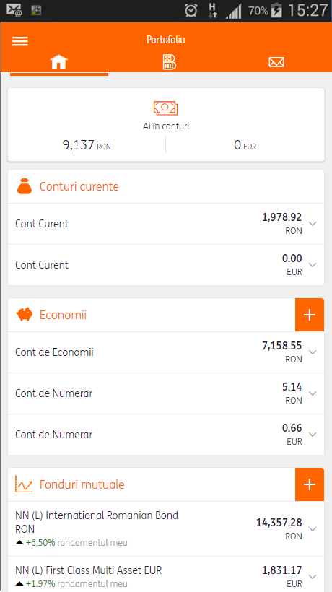
Material produced with the financial support of the European Union. The content of this material is the responsibility of the authors and the National Agency and the European Commission are not responsible for how the content of this information will be used.
Erasmus+ Programme – Strategic Partnership
Project : 2021-2-RO01-KA210-ADU-000048477
Project Title: “Senior in digital era”

Slide 15
DESPRE SĂNĂTATE.....
On the internet we find:
basic information about various conditions
websites of specialist clinics where you can make appointments
specialists in various areas of expertise such as: doctors, nutritionists, psychologists, coaches
recommendations for help
medicine leaflets
medical groups and blogs
Material produced with the financial support of the European Union. The content of this material is the responsibility of the authors and the National Agency and the European Commission are not responsible for how the content of this information will be used.
Erasmus+ Programme – Strategic Partnership
Project : 2021-2-RO01-KA210-ADU-000048477
Project Title: “Senior in digital era”

Slide 16
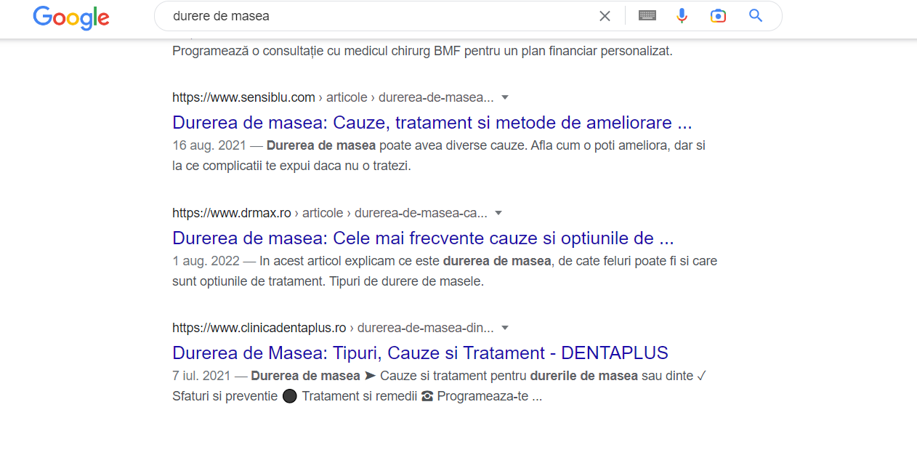
Online information:
Material produced with the financial support of the European Union. The content of this material is the responsibility of the authors and the National Agency and the European Commission are not responsible for how the content of this information will be used.
Erasmus+ Programme – Strategic Partnership
Project : 2021-2-RO01-KA210-ADU-000048477
Project Title: “Senior in digital era”

Slide 17
THANK YOU FOR YOUR ATTENTION!
Material produced with the financial support of the European Union. The content of this material is the responsibility of the authors and the National Agency and the European Commission are not responsible for how the content of this information will be used.
Erasmus+ Programme – Strategic Partnership
Project : 2021-2-RO01-KA210-ADU-000048477
Project Title: “Senior in digital era”

