Slide 1
Seniors in the digital era
-Class support-
Deepening the use of the internet for research and
communication.
Material produced with the financial support of the European Union. The content of this material is the responsibility of the authors and the National Agency and the European Commission are not responsible for how the content of this information will be used.
Erasmus+ Programme – Strategic Partnership
Project : 2021-2-RO01-KA210-ADU-000048477
Project Title: “Senior in digital era”

Slide 2
Summary & questions
Application:
Using your mobile phones you'll send them
A short message including:
How are you feeling today?
Your full name
Material produced with the financial support of the European Union. The content of this material is the responsibility of the authors and the National Agency and the European Commission are not responsible for how the content of this information will be used.
Erasmus+ Programme – Strategic Partnership
Project : 2021-2-RO01-KA210-ADU-000048477
Project Title: “Senior in digital era”

Slide 3
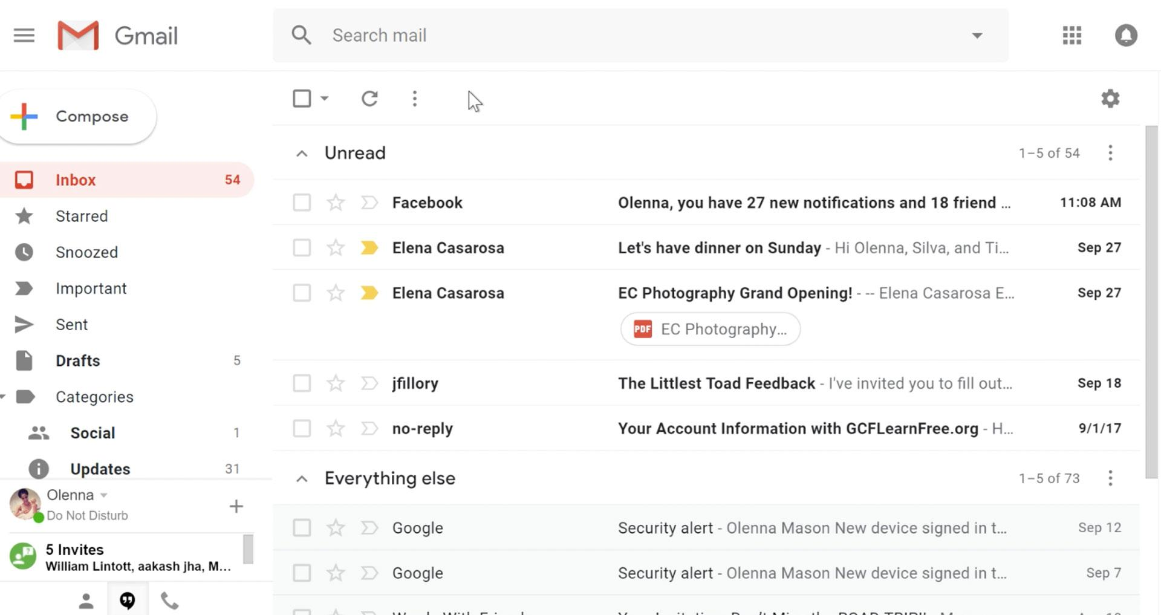
COMMUNICATION
Material produced with the financial support of the European Union. The content of this material is the responsibility of the authors and the National Agency and the European Commission are not responsible for how the content of this information will be used.
Erasmus+ Programme – Strategic Partnership
Project : 2021-2-RO01-KA210-ADU-000048477
Project Title: “Senior in digital era”

Slide 4
COMMUNICATION
Steps for creating an email account:
1.Go to the Google account creation page
2.Follow the steps shown to set up your account.
3.Use the account you created to sign in to Gmail.
4.Choose a username - for example: ioanaanton@gmail.com
Material produced with the financial support of the European Union. The content of this material is the responsibility of the authors and the National Agency and the European Commission are not responsible for how the content of this information will be used.
Erasmus+ Programme – Strategic Partnership
Project : 2021-2-RO01-KA210-ADU-000048477
Project Title: “Senior in digital era”

Slide 5
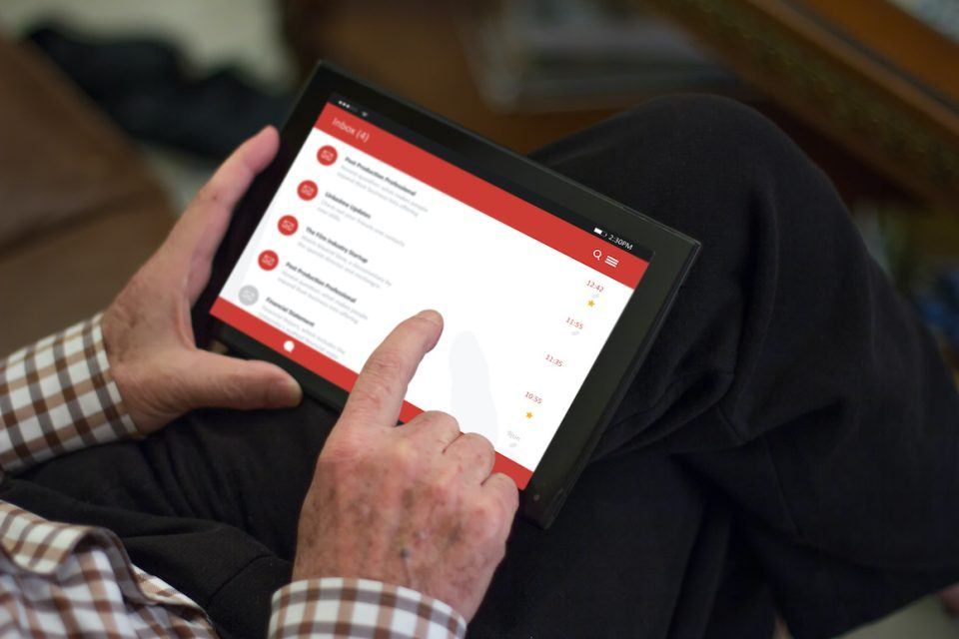
COMMUNICATION
Application:
We're going to fold into several groups and create gmail accounts.
Material produced with the financial support of the European Union. The content of this material is the responsibility of the authors and the National Agency and the European Commission are not responsible for how the content of this information will be used.
Erasmus+ Programme – Strategic Partnership
Project : 2021-2-RO01-KA210-ADU-000048477
Project Title: “Senior in digital era”

Slide 6
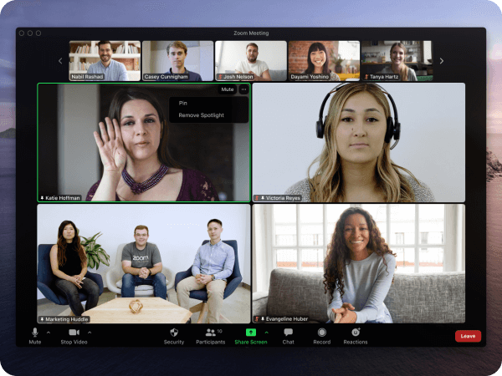
COMMUNICATION
To make a video call, you need two important requirements:
1. stable Internet connection
2. an application or program that allows you to make a video call
Material produced with the financial support of the European Union. The content of this material is the responsibility of the authors and the National Agency and the European Commission are not responsible for how the content of this information will be used.
Erasmus+ Programme – Strategic Partnership
Project : 2021-2-RO01-KA210-ADU-000048477
Project Title: “Senior in digital era”

Slide 7
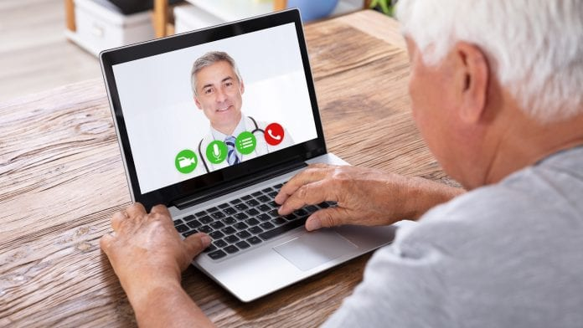
COMMUNICATION
Examples of applications:
1.Skype
2.Zoom
3.Facetime
4.What up
Material produced with the financial support of the European Union. The content of this material is the responsibility of the authors and the National Agency and the European Commission are not responsible for how the content of this information will be used.
Erasmus+ Programme – Strategic Partnership
Project : 2021-2-RO01-KA210-ADU-000048477
Project Title: “Senior in digital era”

Slide 8
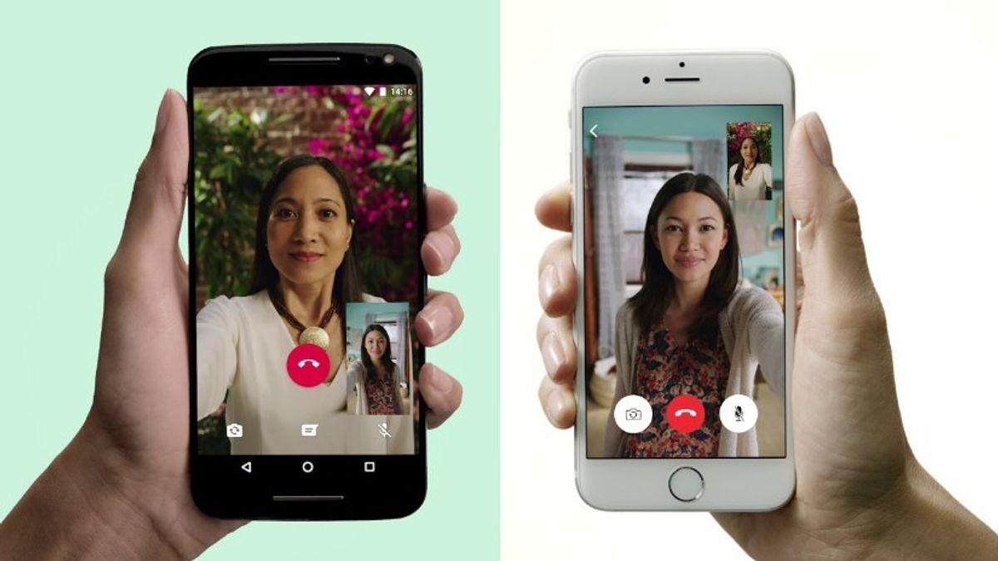
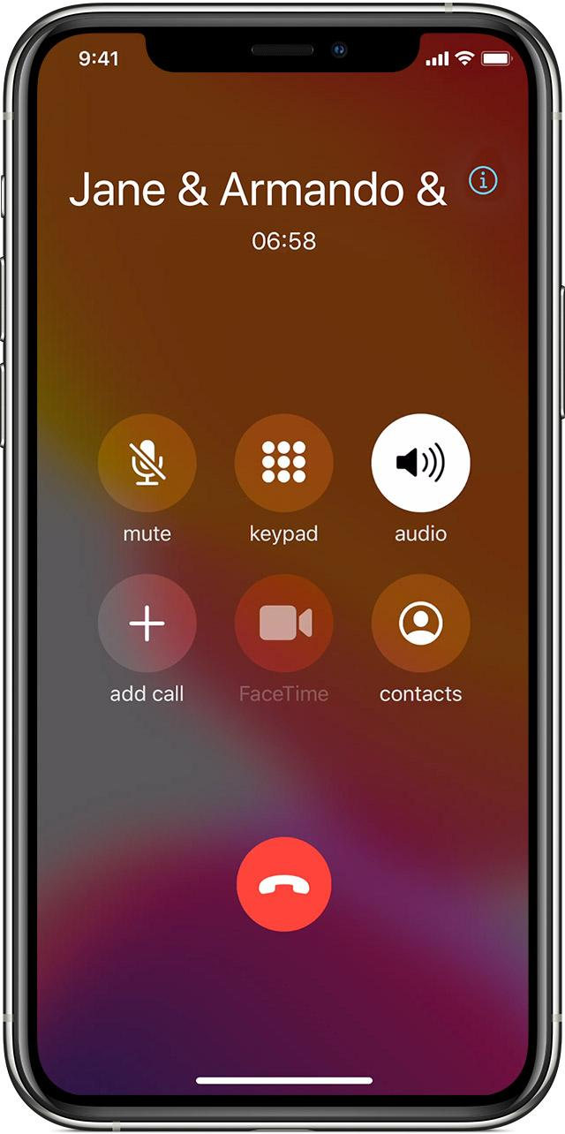
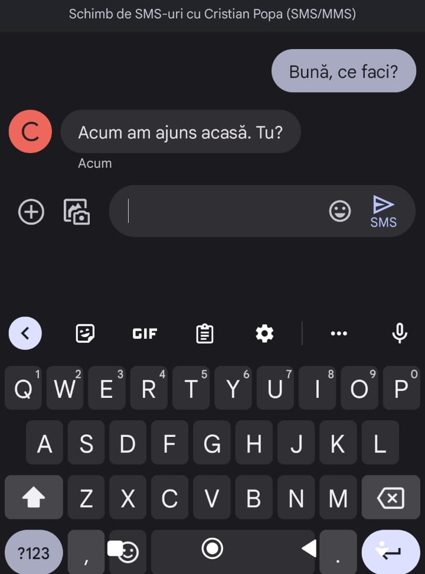
Aplicații care ne permit mai multe funcții
COMMUNICATION
Applications that we
allow more functions
Material produced with the financial support of the European Union. The content of this material is the responsibility of the authors and the National Agency and the European Commission are not responsible for how the content of this information will be used.
Erasmus+ Programme – Strategic Partnership
Project : 2021-2-RO01-KA210-ADU-000048477
Project Title: “Senior in digital era”

Slide 9
Online Messaging App
We'll make a video call together on Whats-up.
First we'll choose
one person to make the call and one person to receive it.
Material produced with the financial support of the European Union. The content of this material is the responsibility of the authors and the National Agency and the European Commission are not responsible for how the content of this information will be used.
Erasmus+ Programme – Strategic Partnership
Project : 2021-2-RO01-KA210-ADU-000048477
Project Title: “Senior in digital era”

Slide 10
SOCIAL NETWORKS
FACEBOOK
INSTAGRAM
TIK-TOK
Application*
Material produced with the financial support of the European Union. The content of this material is the responsibility of the authors and the National Agency and the European Commission are not responsible for how the content of this information will be used.
Erasmus+ Programme – Strategic Partnership
Project : 2021-2-RO01-KA210-ADU-000048477
Project Title: “Senior in digital era”

Slide 11
TECHNOLOGY FOR SENIORS
Exemple:
Smart home
Intelligent lighting system
Smart watches
Telemedicine
Smart oven
Blood pressure apps
Material produced with the financial support of the European Union. The content of this material is the responsibility of the authors and the National Agency and the European Commission are not responsible for how the content of this information will be used.
Erasmus+ Programme – Strategic Partnership
Project : 2021-2-RO01-KA210-ADU-000048477
Project Title: “Senior in digital era”

Slide 12
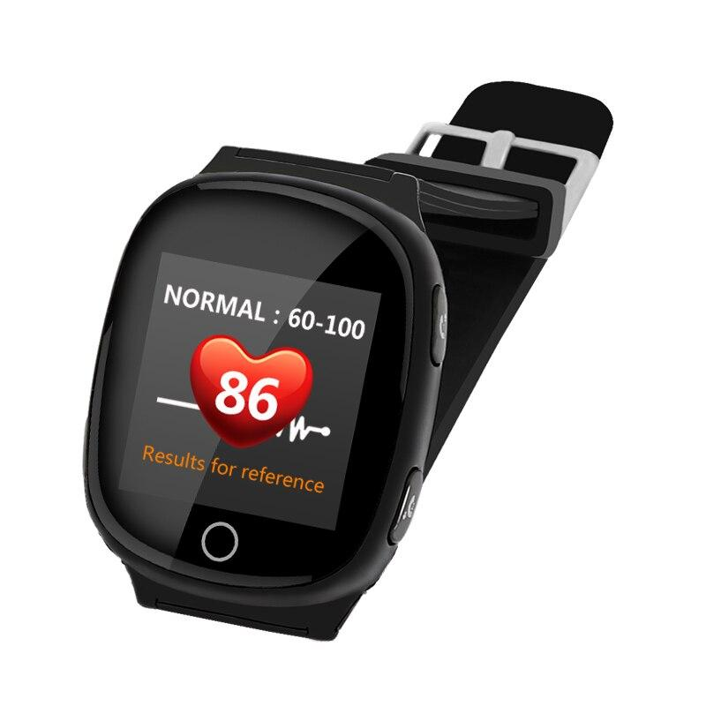
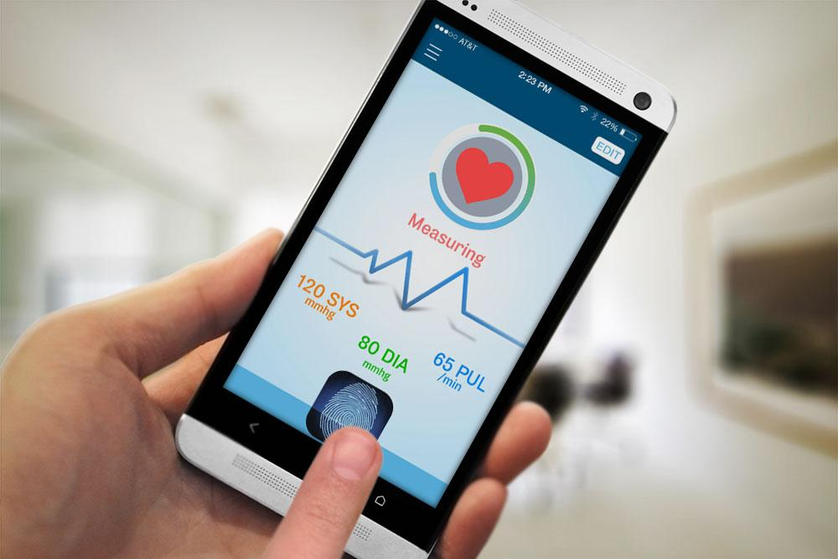
HEALTH
Material produced with the financial support of the European Union. The content of this material is the responsibility of the authors and the National Agency and the European Commission are not responsible for how the content of this information will be used.
Erasmus+ Programme – Strategic Partnership
Project : 2021-2-RO01-KA210-ADU-000048477
Project Title: “Senior in digital era”

Slide 13
Application:
The trainers will go through each one individually and exemplify
how the blood pressure app works.
Material produced with the financial support of the European Union. The content of this material is the responsibility of the authors and the National Agency and the European Commission are not responsible for how the content of this information will be used.
Erasmus+ Programme – Strategic Partnership
Project : 2021-2-RO01-KA210-ADU-000048477
Project Title: “Senior in digital era”

Slide 14
THANK YOU FOR YOUR ATTENTION!
Material produced with the financial support of the European Union. The content of this material is the responsibility of the authors and the National Agency and the European Commission are not responsible for how the content of this information will be used.
Erasmus+ Programme – Strategic Partnership
Project : 2021-2-RO01-KA210-ADU-000048477
Project Title: “Senior in digital era”

