Slide 1
Seniors in the digital era
-COURSE MATERIAL-
Masterclass:
Familiarisation with the online environment and specific utilities
(research, communication, commerce, administration and lifestyle)
Material produced with the financial support of the European Union. The content of this material is the responsibility of the authors and the National Agency and the European Commission are not responsible for how the content of this information will be used.
Erasmus+ Programme – Strategic Partnership
Project : 2021-2-RO01-KA210-ADU-000048477
Project Title: “Senior in digital era”

Slide 2
Trainers app
Seniors app ☺
Material produced with the financial support of the European Union. The content of this material is the responsibility of the authors and the National Agency and the European Commission are not responsible for how the content of this information will be used.
Erasmus+ Programme – Strategic Partnership
Project : 2021-2-RO01-KA210-ADU-000048477
Project Title: “Senior in digital era”

Slide 3
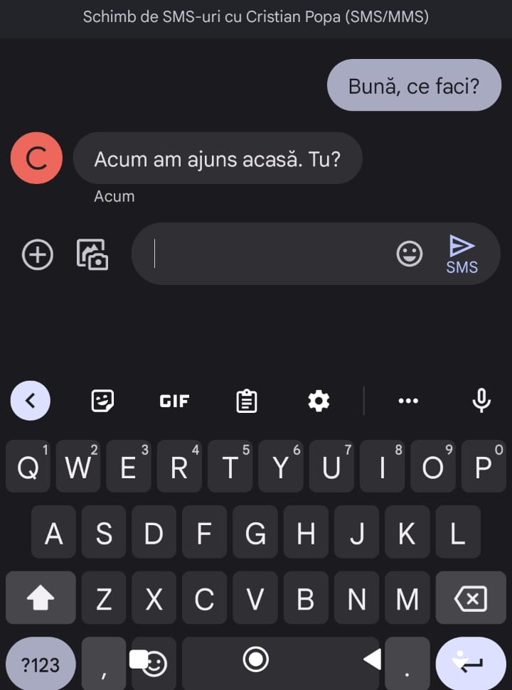
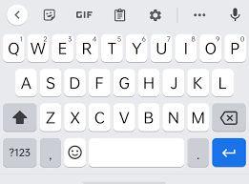
*APPLICATION*-Hello! How are you?
SHIFT
Delete text
BACKSPACE
Gives you uppercase to lowercase letter exchange
ENTER
Start new line of text
SPACEBAR
Add space between characters
Material produced with the financial support of the European Union. The content of this material is the responsibility of the authors and the National Agency and the European Commission are not responsible for how the content of this information will be used.
Erasmus+ Programme – Strategic Partnership
Project : 2021-2-RO01-KA210-ADU-000048477
Project Title: “Senior in digital era”

Slide 4
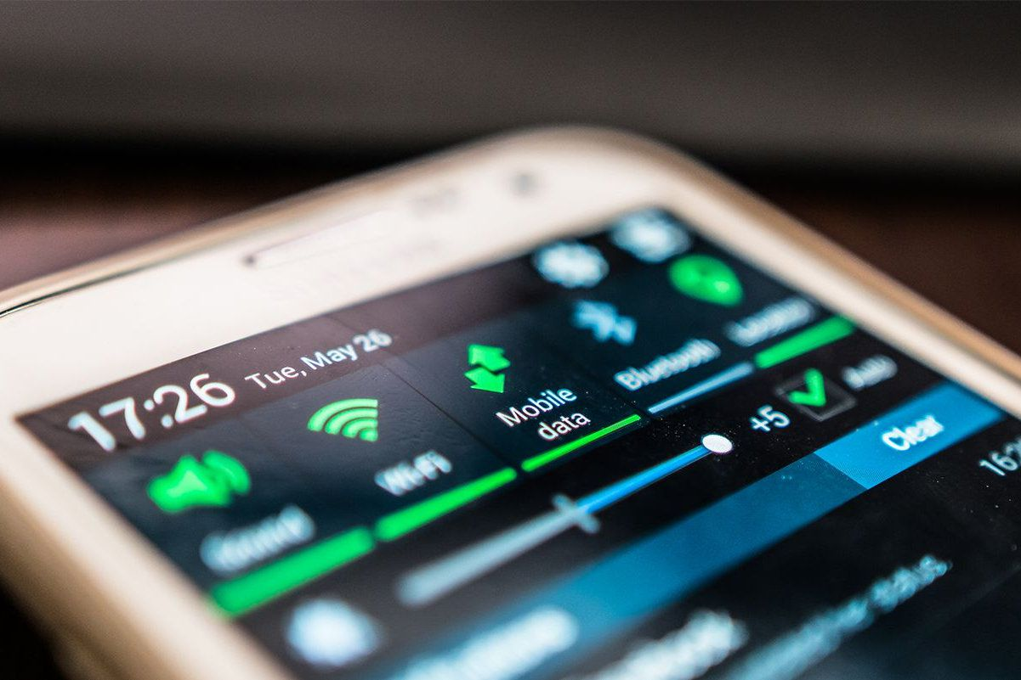
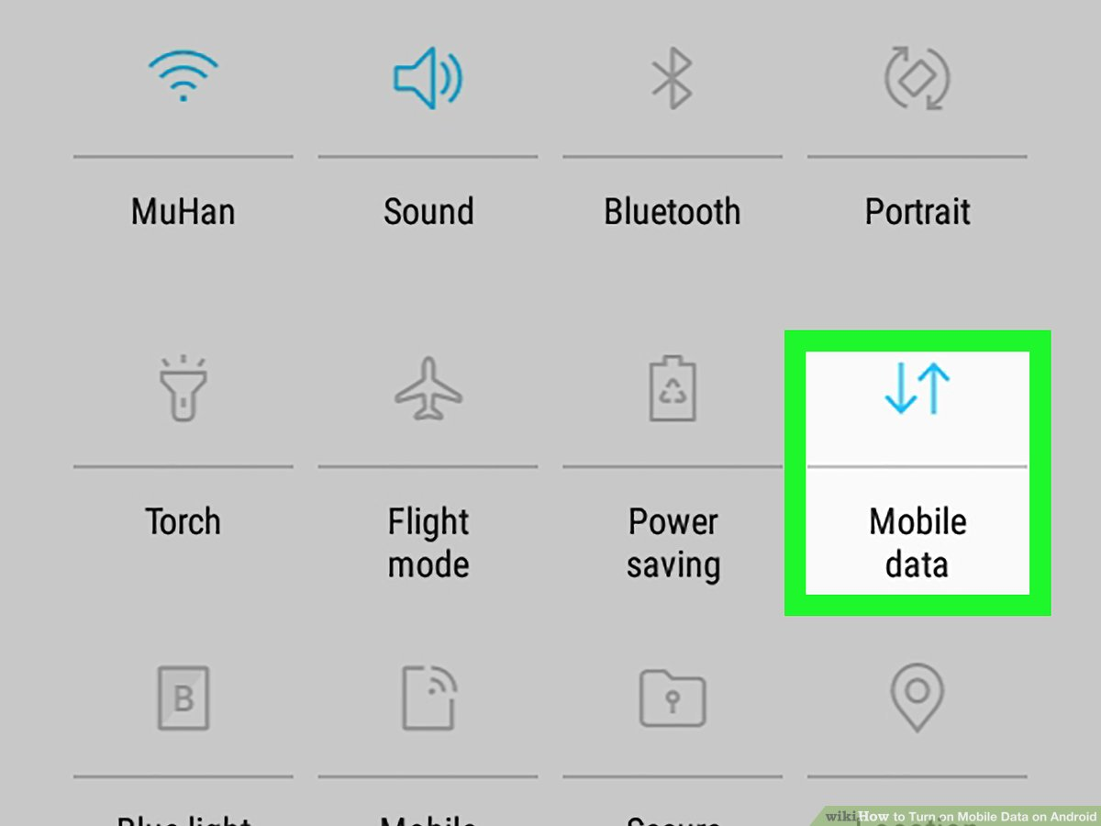
Internet application
Material produced with the financial support of the European Union. The content of this material is the responsibility of the authors and the National Agency and the European Commission are not responsible for how the content of this information will be used.
Erasmus+ Programme – Strategic Partnership
Project : 2021-2-RO01-KA210-ADU-000048477
Project Title: “Senior in digital era”

Slide 5
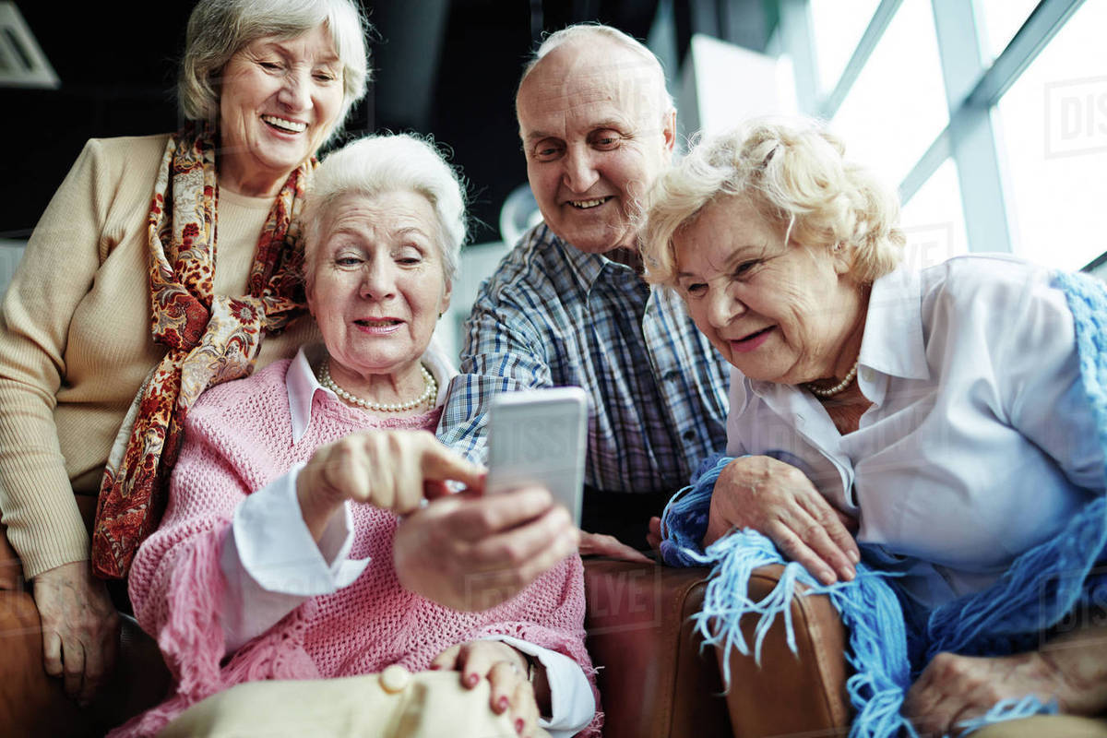
*APPLICATION*- photograph and search
Material produced with the financial support of the European Union. The content of this material is the responsibility of the authors and the National Agency and the European Commission are not responsible for how the content of this information will be used.
Erasmus+ Programme – Strategic Partnership
Project : 2021-2-RO01-KA210-ADU-000048477
Project Title: “Senior in digital era”

Slide 6
Further information about the online environment
Surfing
Analysis, interpretation and critical evaluation of data
Interacting with digital technologies
Engaging in citizenship with digital technologies
Managing digital identity:
Material produced with the financial support of the European Union. The content of this material is the responsibility of the authors and the National Agency and the European Commission are not responsible for how the content of this information will be used.
Erasmus+ Programme – Strategic Partnership
Project : 2021-2-RO01-KA210-ADU-000048477
Project Title: “Senior in digital era”

Slide 7
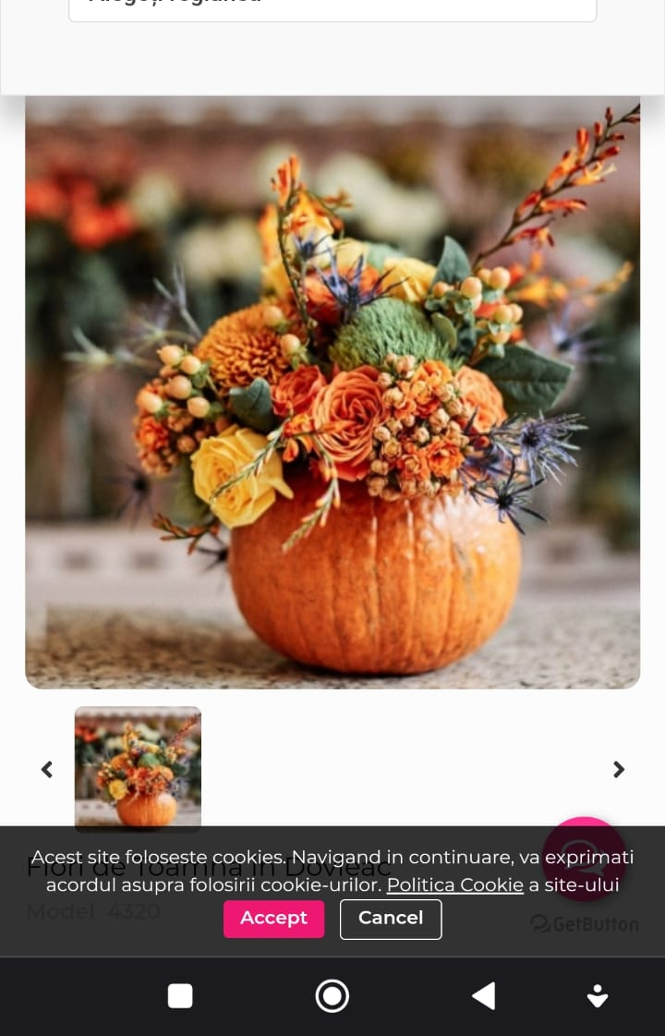
*APPLICATION*- pictures on the internet
Material produced with the financial support of the European Union. The content of this material is the responsibility of the authors and the National Agency and the European Commission are not responsible for how the content of this information will be used.
Erasmus+ Programme – Strategic Partnership
Project : 2021-2-RO01-KA210-ADU-000048477
Project Title: “Senior in digital era”

Slide 8
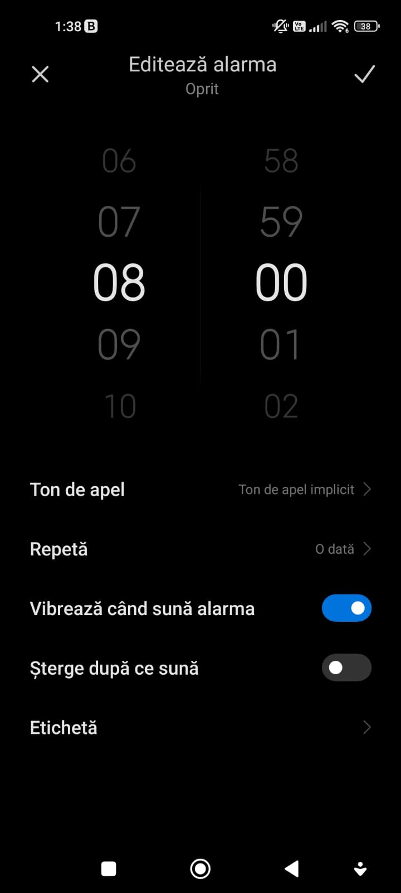
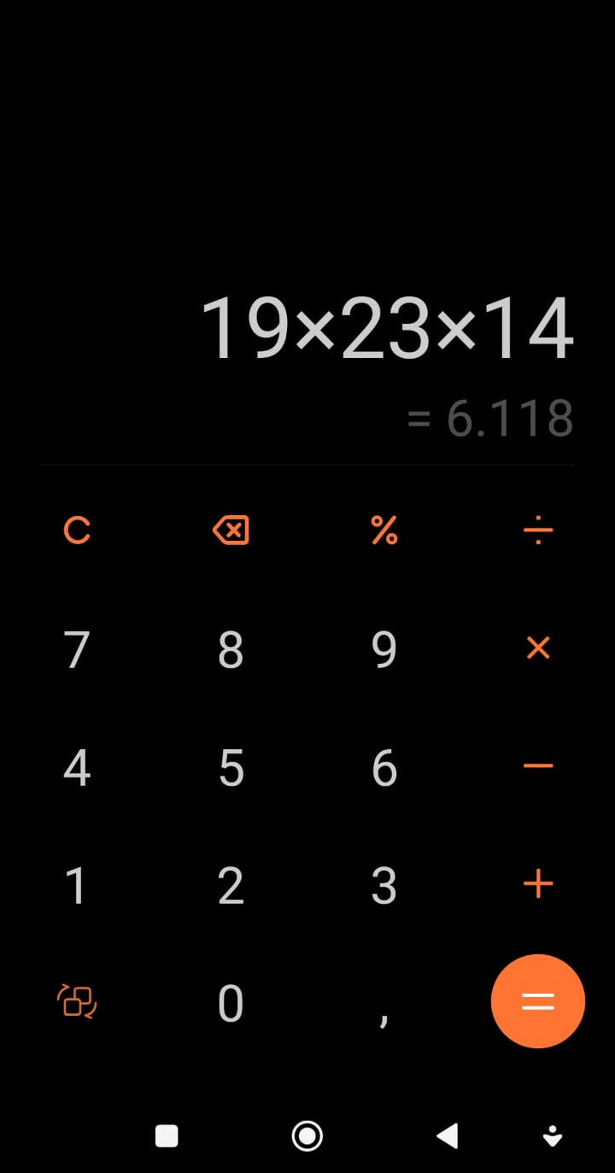
SMARTPHONE –no secrets
Material produced with the financial support of the European Union. The content of this material is the responsibility of the authors and the National Agency and the European Commission are not responsible for how the content of this information will be used.
Erasmus+ Programme – Strategic Partnership
Project : 2021-2-RO01-KA210-ADU-000048477
Project Title: “Senior in digital era”

Slide 9
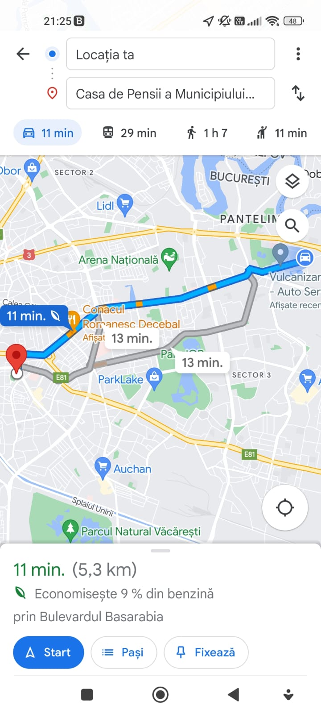
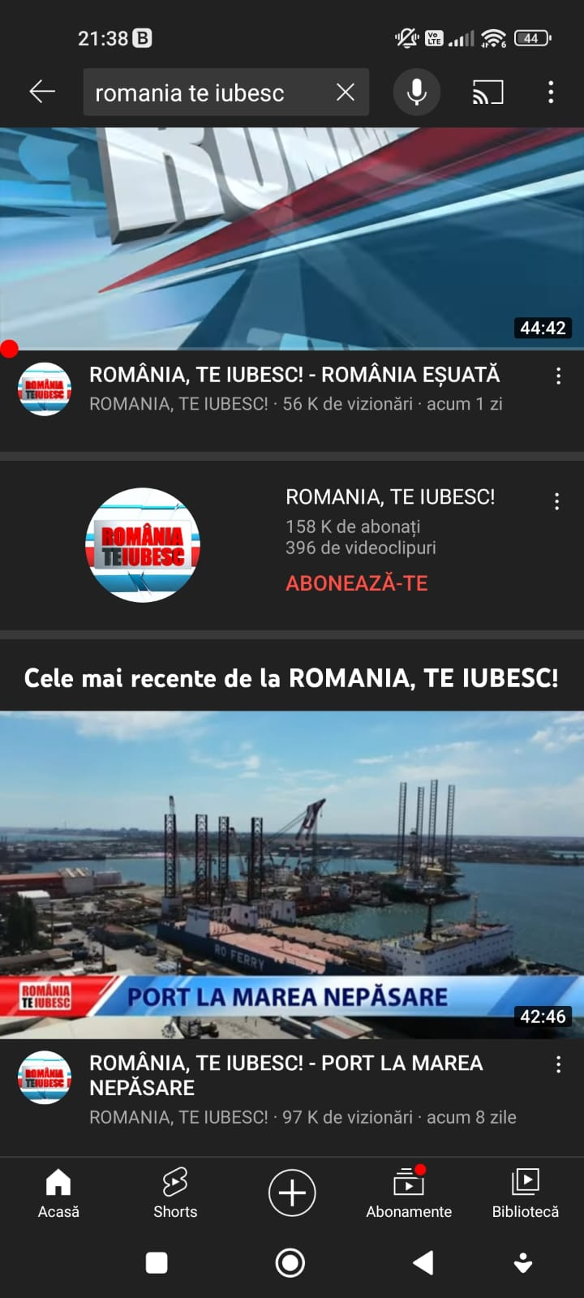
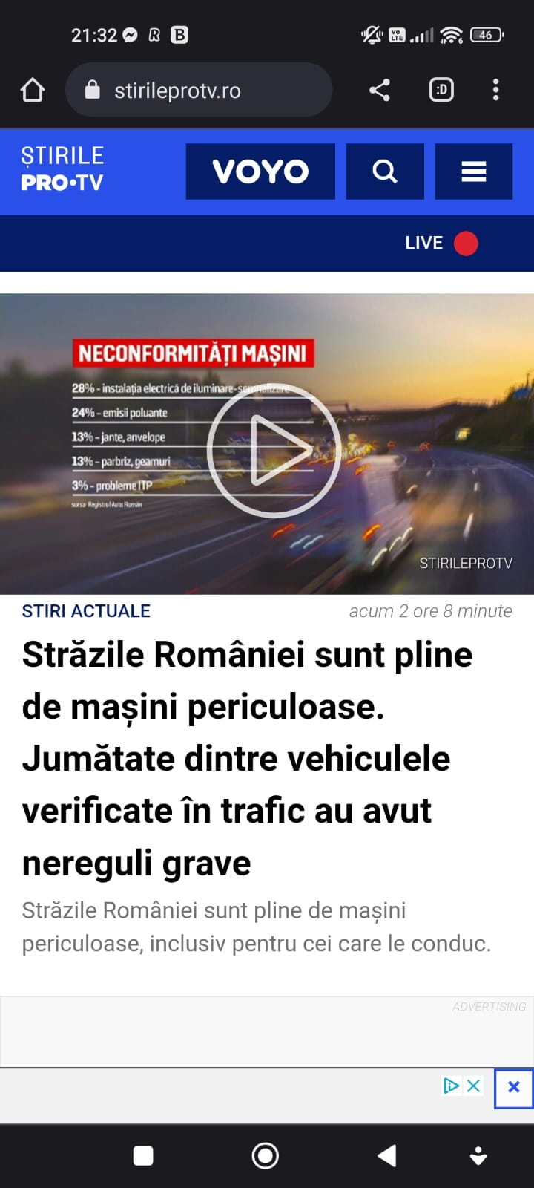
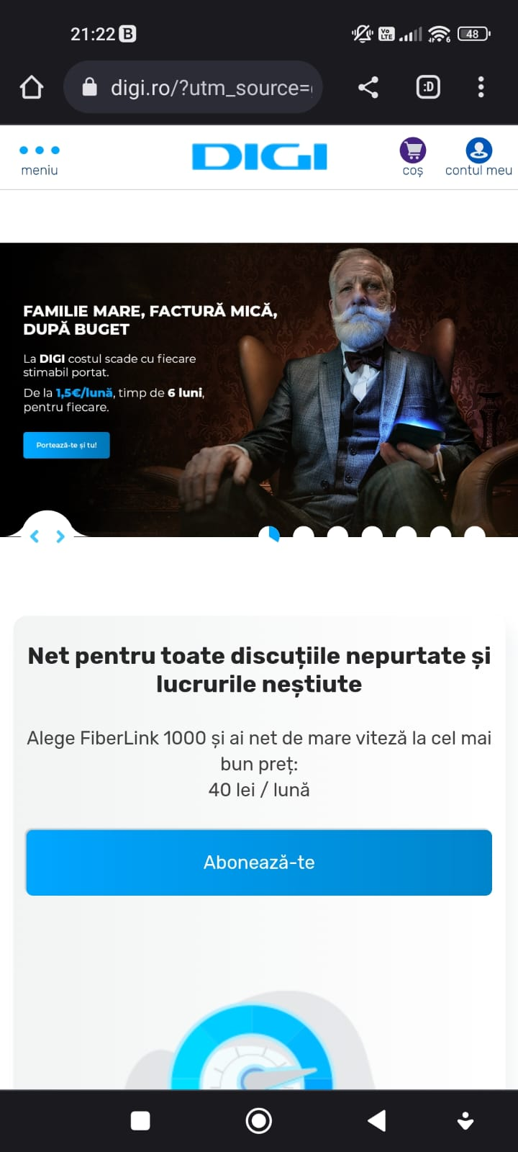
INTERNET FOR EVERYONE!
Material produced with the financial support of the European Union. The content of this material is the responsibility of the authors and the National Agency and the European Commission are not responsible for how the content of this information will be used.
Erasmus+ Programme – Strategic Partnership
Project : 2021-2-RO01-KA210-ADU-000048477
Project Title: “Senior in digital era”

Slide 10
THANKS FOR YOUR ATTENTION!
Material produced with the financial support of the European Union. The content of this material is the responsibility of the authors and the National Agency and the European Commission are not responsible for how the content of this information will be used.
Erasmus+ Programme – Strategic Partnership
Project : 2021-2-RO01-KA210-ADU-000048477
Project Title: “Senior in digital era”

